Slide 1
SET OPTIONS (Transact-SQL)

Slide 2
SET OPTIONS (Transact-SQL)
SET NOCOUNT
SET ROWCOUNT
SET XACT_ABORT
SET IDENTITY_INSERT
SET ANSI_NULLS

Slide 3
SET NOCOUNT (Transact-SQL)
Stops the message that shows the count of the number of rows affected by a Transact-SQL statement or stored procedure from being returned as part of the result set.
SYNTAX :
SET NOCOUNT { ON | OFF }
When SET NOCOUNT is ON, the count is not returned. When SET NOCOUNT is OFF, the count is returned

Slide 4
SET NOCOUNT (Transact-SQL)
Prevents the sending of DONE_IN_PROC messages to the client for each statement in a stored procedure.
SELECT, INSERT, UPDATE, and DELETE statements
provides a significant performance boost, because network traffic is greatly reduced.
The setting specified by SET NOCOUNT is in effect at execute TIME.

Slide 5
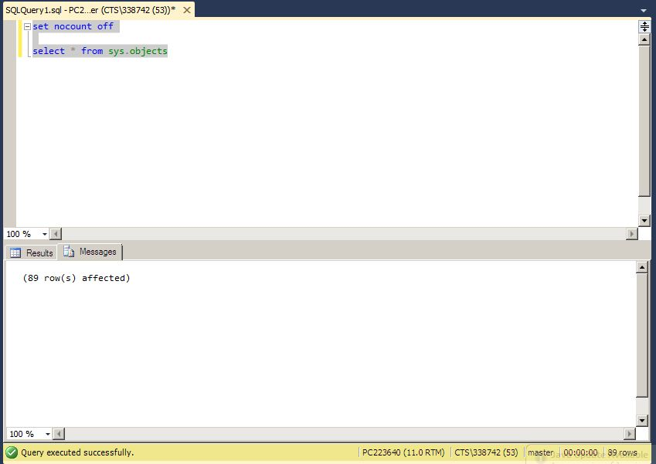
EXAMPLE

Slide 6
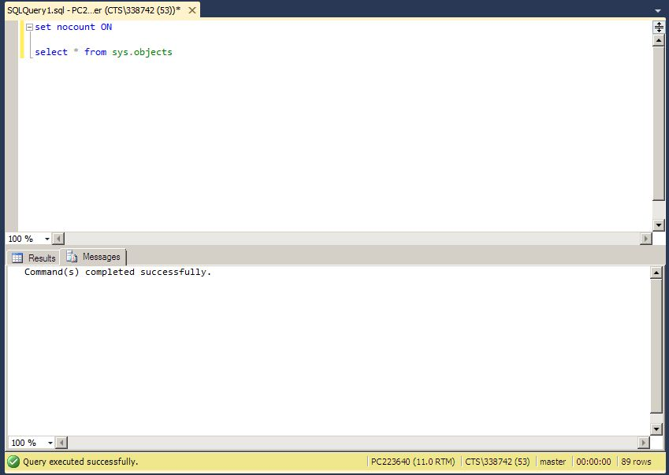
EXAMPLE

Slide 7
SET ROWCOUNT
Causes SQL Server to stop processing the query after the specified number of rows are returned.
SYNTAX :
SET ROWCOUNT { number | @number_var }
number | @number_var
Is the number, an integer, of rows to be processed before stopping the specific query.

Slide 8
SET ROWCOUNT
SET ROWCOUNT overrides the SELECT statement TOP keyword if the rowcount is the smaller value.
The setting of SET ROWCOUNT is set at execute time.
To set this option off so that all rows are returned, specify SET ROWCOUNT 0.

Slide 9
EXAMPLE
USE AdventureWorks2012;
GO
SELECT count(*) AS Count FROM Production.ProductInventory WHERE Quantity < 300;
GO
RESULT :
Count
-----------
537
(1 row(s) affected)

Slide 10
EXAMPLE
USE AdventureWorks2012;
GO
SET ROWCOUNT 4;
SELECT * FROM Production.ProductInventory WHERE Quantity < 300;
GO
RESULT :
(4 row(s) affected)

Slide 11
SET XACT_ABORT
Specifies whether SQL Server automatically rolls back the current transaction when a Transact-SQL statement raises a run-time error.
SYNTAX :
SET XACT_ABORT { ON | OFF }
When SET XACT_ABORT is ON, if a Transact-SQL statement raises a run-time error, the entire transaction is terminated and rolled back.

Slide 12
SET XACT_ABORT
When SET XACT_ABORT is OFF, in some cases only the Transact-SQL statement that raised the error is rolled back and the transaction continues processing.
Compile errors, such as syntax errors, are not affected by SET XACT_ABORT.
The setting of SET XACT_ABORT is set at execute time.
EXAMPLE

Slide 13
SET IDENTITY_INSERT
Allows explicit values to be inserted into the identity column of a table.
SYNTAX :
SET IDENTITY_INSERT [ database_name . [ schema_name ] . ] table { ON | OFF }
At any time, only one table in a session can have the IDENTITY_INSERT property set to ON.

Slide 14
SET IDENTITY_INSERT
If the value inserted is larger than the current identity value for the table, SQL Server automatically uses the new inserted value as the current identity value.
The setting of SET IDENTITY_INSERT is set at execute or run time and not at parse time.
EXAMPLE

Slide 15
SET ANSI_DEFAULTS (Transact-SQL)
Controls a group of SQL Server settings that collectively specify some ISO standard behavior.
SYNTAX :
  SET ANSI_DEFAULTS { ON | OFF }
When enabled (ON), this option enables the following ISO settings:

Slide 16
SET ANSI_DEFAULTS (Transact-SQL)
SET ANSI_NULLS
SET ANSI_NULL_DFLT_ON
SET ANSI_PADDING
SET ANSI_WARNINGS
SET CURSOR_CLOSE_ON_COMMIT
SET IMPLICIT_TRANSACTIONS
SET QUOTED_IDENTIFIER

Slide 17
SET ANSI_DEFAULTS (Transact-SQL)
When dealing with indexes on computed columns and indexed views, four of these defaults (ANSI_NULLS, ANSI_PADDING, ANSI_WARNINGS, and QUOTED_IDENTIFIER) must be set to ON.
SET ANSI_DEFAULTS is a server-side setting that the client does not modify.
        EXAMPLE

Slide 18
SET ANSI_NULLS
When SET ANSI_NULLS is OFF, the Equals (=) and Not Equal To (<>) comparison operators do not follow the ISO standard.
A SELECT statement that uses WHERE column_name = NULL returns the rows that have null values in column_name.
When SET ANSI_NULLS is ON, all comparisons against a null value evaluate to UNKNOWN.
When SET ANSI_NULLS is OFF, comparisons of all data against a null value evaluate to TRUE if the data value is NULL

Slide 19
SET ANSI_NULLS
Specifies ISO compliant behavior of the Equals (=) and Not Equal To (<>) comparison operators when they are used with null values.
SYNTAX :
SET ANSI_NULLS { ON | OFF }
When SET ANSI_NULLS is ON, a SELECT statement that uses WHERE column_name = NULL returns zero rows even if there are null values in column_name. A SELECT statement that uses WHERE column_name <> NULL returns zero rows even if there are nonnull values in column_name.

Slide 20
SET ANSI_NULLS
For a script to work as intended, regardless of the ANSI_NULLS database option use
IS NULL & IS NOT NULL
SET ANSI_NULLS must also be ON while creating or changing indexes on computed columns or indexed views,else CRUD statements will fail.
When SET ANSI_DEFAULTS is ON, SET ANSI_NULLS is enabled.

Slide 21
SET IMPLICIT_TRANSACTIONS
Sets implicit transaction mode for the connection.
SYNTAX :
SET IMPLICIT_TRANSACTIONS { ON | OFF }
When ON, SET IMPLICIT_TRANSACTIONS sets the connection into implicit transaction mode. When OFF, it returns the connection to autocommit transaction mode.

Slide 22
SET IMPLICIT_TRANSACTIONS
ALTER TABLE | FETCH | REVOKE
BEGIN TRANSACTION | GRANT | SELECT
CREATE | INSERT | TRUNCATE TABLE
DELETE | OPEN | UPDATE
DROP

Slide 23
SET IMPLICIT_TRANSACTIONS
When the setting is ON transactions must be explicitly committed or rolled back by the user at the end of the transaction.
Implicit transaction mode remains in effect until the connection executes a SET IMPLICIT_TRANSACTIONS OFF statement.
When SET ANSI_DEFAULTS is ON, SET IMPLICIT_TRANSACTIONS is ON.

Slide 24
SET QUOTED_IDENTIFIER (Transact-SQL)
Causes SQL Server to follow the ISO rules regarding quotation mark delimiting identifiers and literal strings.
Identifiers delimited by double quotation marks can be either Transact-SQL reserved keywords.
It can contain characters not generally allowed by the Transact-SQL syntax rules for identifiers.
SYNTAX :
SET QUOTED_IDENTIFIER { ON | OFF }

Slide 25
SET QUOTED_IDENTIFIER (Transact-SQL)
When SET QUOTED_IDENTIFIER is ON, identifiers can be delimited by double quotation marks, and literals must be delimited by single quotation marks.
When SET QUOTED_IDENTIFIER is OFF, identifiers cannot be quoted and must follow all Transact-SQL rules for identifiers.
When a stored procedure is created, the SET QUOTED_IDENTIFIER and SET ANSI_NULLS settings are captured and used for subsequent invocations of that stored procedure.

Slide 26
SET QUOTED_IDENTIFIER (Transact-SQL)
When a table is created, the QUOTED IDENTIFIER option is always stored as ON in the table's metadata even if the option is set to OFF when the table is created.
When SET ANSI_DEFAULTS is ON, SET QUOTED_IDENTIFIER is enabled.
SET QUOTED_IDENTIFIER is set at parse time.

Slide 27
SET CONCAT_NULL_YIELDS_NULL
Controls whether concatenation results are treated as null or empty string values.
When SET CONCAT_NULL_YIELDS_NULL is ON, concatenating a null value with a string yields a NULL result.
When SET CONCAT_NULL_YIELDS_NULL is OFF, concatenating a null value with a string yields the string itself.

Slide 28
SET CONCAT_NULL_YIELDS_NULL
If SET CONCAT_NULL_YIELDS is not specified, the setting of the CONCAT_NULL_YIELDS_NULL database option applies.
SET CONCAT_NULL_YIELDS_NULL must be ON when you are creating or changing indexes on computed columns or indexed views.
EXAMPLE

Slide 29
SET NOEXEC (Transact-SQL)
Compiles each query but does not execute it.
SYNTAX :
SET NOEXEC { ON | OFF }
When SET NOEXEC is ON, SQL Server compiles each batch of Transact-SQL statements but does not execute them.
When SET NOEXEC is OFF, all batches are executed after compilation.

Slide 30
SET ARITHABORT (Transact-SQL)
Terminates a query when an overflow or divide-by-zero error occurs during query execution.
SYNTAX :
SET ARITHABORT { ON | OFF } [ ; ]
If SET ARITHABORT is ON and SET ANSI WARNINGS is ON, these error conditions cause the query to terminate.

Slide 31
SET ARITHABORT (Transact-SQL)
If SET ARITHABORT is ON and SET ANSI WARNINGS is OFF, these error conditions cause the batch to terminate.
If the errors occur in a transaction, the transaction is rolled back.
If SET ARITHABORT is OFF and one of these errors occurs, a warning message is displayed, and NULL is assigned to the result of the arithmetic operation.
If either SET ARITHABORT is OFF and SET ANSI_WARNINGS is ON, SQL Server still returns an error message when encountering divide-by-zero or overflow errors

